Slide 1

Chapter 8: Project Quality Management
Information Technology Project Management, Seventh Edition
ĐẶNG THỊ THU HÀ – SE
dtthuha79@gmail.com
https://lms.iuh.edu.vn
.

Slide 2
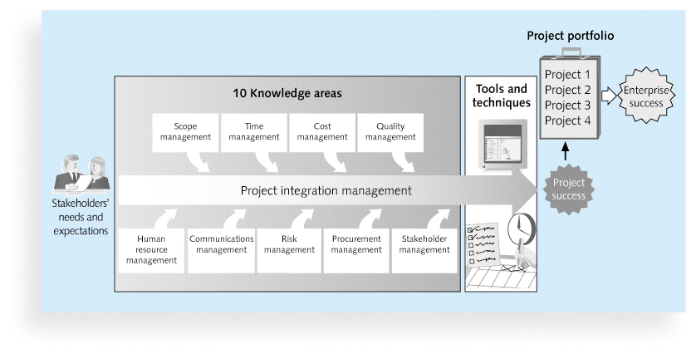

Slide 3
Learning Objectives
Understand the importance of project quality management for information technology (IT) products and services
Define project quality management and understand how quality relates to various aspects of IT projects
Describe quality management planning and how quality and scope management are related.
Understand the tools and techniques for quality control, such as the Seven Basic Tools of Quality

Slide 4
What Is Project Quality?
The International Organization for Standardization (ISO) defines quality as “the degree to which a set of inherent characteristics fulfils requirements” (ISO9000:2000)
Other experts define quality based on:
Conformance to requirements: The project’s processes and products meet written specifications
Fitness for use: A product can be used as it was intended

Slide 5
What Is Project Quality Management?
Project quality management ensures that the project will satisfy the needs for which it was undertaken
Processes include:
Planning quality management: Identifying which quality standards are relevant to the project and how to satisfy them; a metric is a standard of measurement
Performing quality assurance: Periodically evaluating overall project performance to ensure the project will satisfy the relevant quality standards
Performing quality control: Monitoring specific project results to ensure that they comply with the relevant quality standards

Slide 6
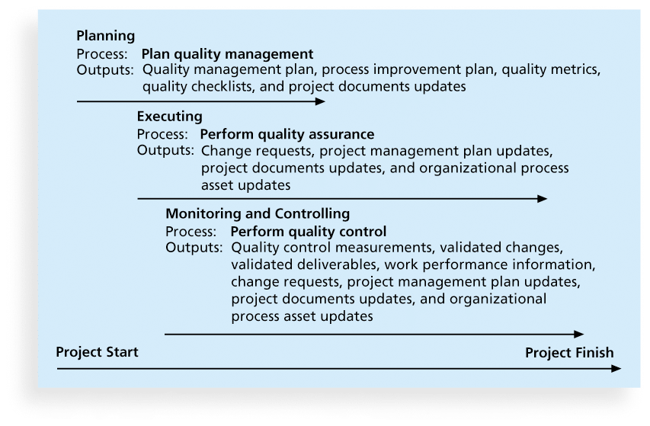
Figure 8-1. Project Quality Management Summary

Slide 7
Planning Quality
Implies the ability to anticipate situations and prepare actions to bring about the desired outcome
Important to prevent defects by:
Selecting proper materials
Training and indoctrinating people in quality
Planning a process that ensures the appropriate outcome

Slide 8
Scope Aspects of IT Projects
Functionality is the degree to which a system performs its intended function
Features are the system’s special characteristics that appeal to users
System outputs are the screens and reports the system generates
Performance addresses how well a product or service performs the customer’s intended use
Reliability is the ability of a product or service to perform as expected under normal conditions
Maintainability addresses the ease of performing maintenance on a product

Slide 9
Who’s Responsible for the Quality of Projects?
Project managers are ultimately responsible for quality management on their projects
Several organizations and references can help project managers and their teams understand quality
International Organization for Standardization (www.iso.org)
IEEE (www.ieee.org)

Slide 10
Performing Quality Assurance
Quality assurance includes all the activities related to satisfying the relevant quality standards for a project
Another goal of quality assurance is continuous quality improvement
Benchmarking generates ideas for quality improvements by comparing specific project practices or product characteristics to those of other projects or products within or outside the performing organization
A quality audit is a structured review of specific quality management activities that help identify lessons learned that could improve performance on current or future projects

Slide 11
Controlling Quality
The main outputs of quality control are:
Acceptance decisions
Rework
Process adjustments
There are Seven Basic Tools of Quality that help in performing quality control

Slide 12
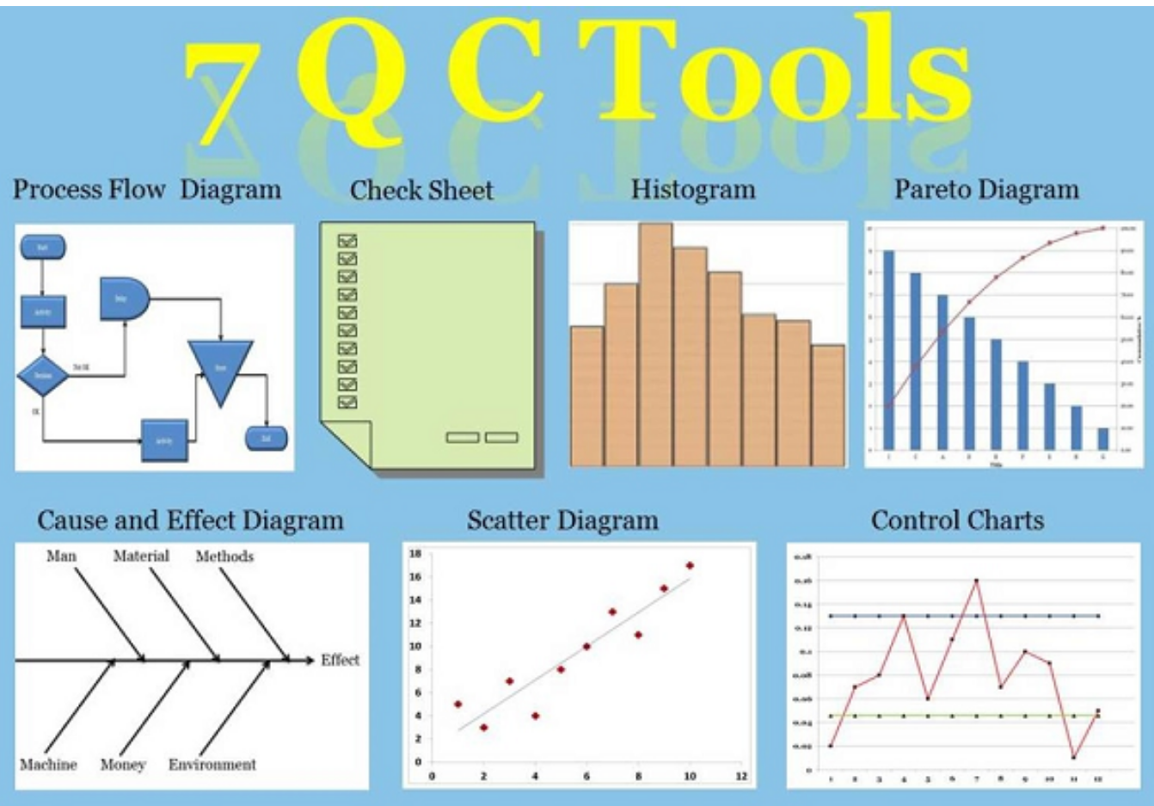

Slide 13
Flowcharts
Flowcharts are graphic displays of the logic and flow of processes that help you analyze how problems occur and how processes can be improved
They show activities, decision points, and the order of how information is processed

Slide 14
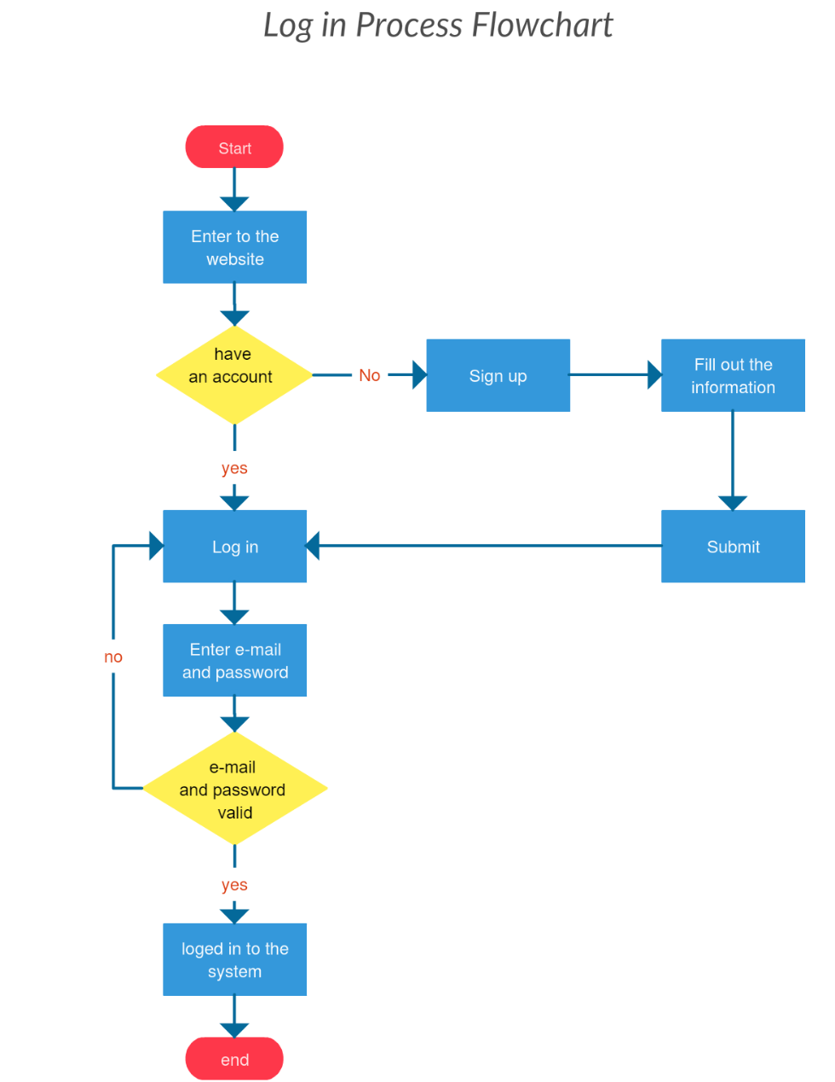
Figure 8-8. Sample Flowchart

Slide 15
Checksheet
A checksheet is used to collect and analyze data
It is sometimes called a tally sheet or checklist, depending on its format
In the example in Figure 8-4, most complaints arrive via text message, and there are more complaints on Monday and Tuesday than on other days of the week
This information might be useful in improving the process for handling complaints

Slide 16
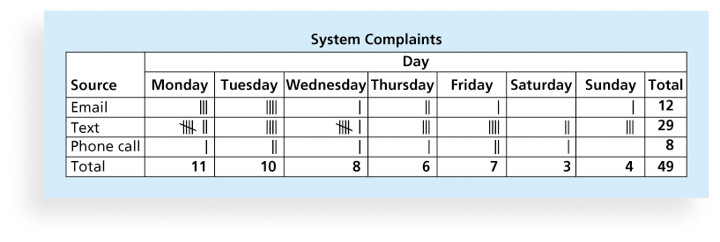
Figure 8-4. Sample Checksheet

Slide 17
Histograms
A histogram is a bar graph of a distribution of variables
Each bar represents an attribute or characteristic of a problem or situation, and the height of the bar represents its frequency

Slide 18
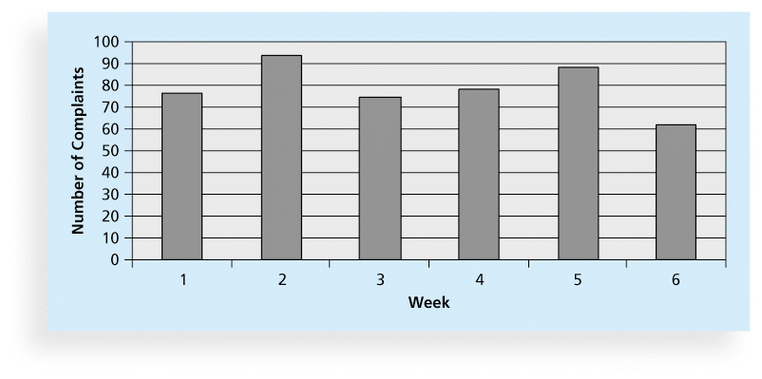
Figure 8-6. Sample Histogram

Slide 19
Pareto Charts
A Pareto chart is a histogram that can help you identify and prioritize problem areas
Pareto analysis is also called the 80-20 rule, meaning that 80 percent of problems are often due to 20 percent of the causes

Slide 20
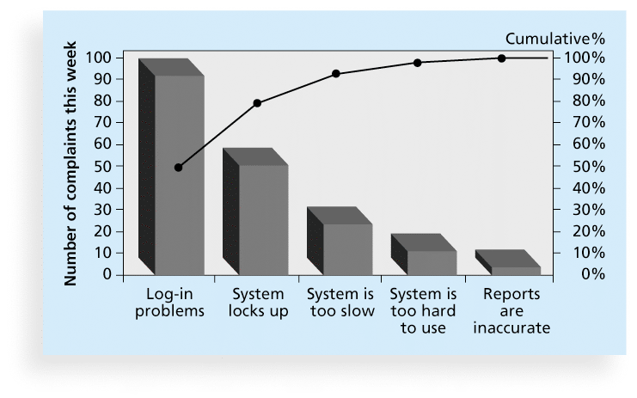
Figure 8-7. Sample Pareto Chart

Slide 21
Cause-and-Effect Diagrams
Cause-and-effect diagrams trace complaints about quality problems back to the responsible production operations
They help you find the root cause of a problem
Also known as fishbone or Ishikawa diagrams
Can also use the 5 whys technique where you repeated ask the question “Why” (five is a good rule of thumb) to peel away the layers of symptoms that can lead to the root cause

Slide 22
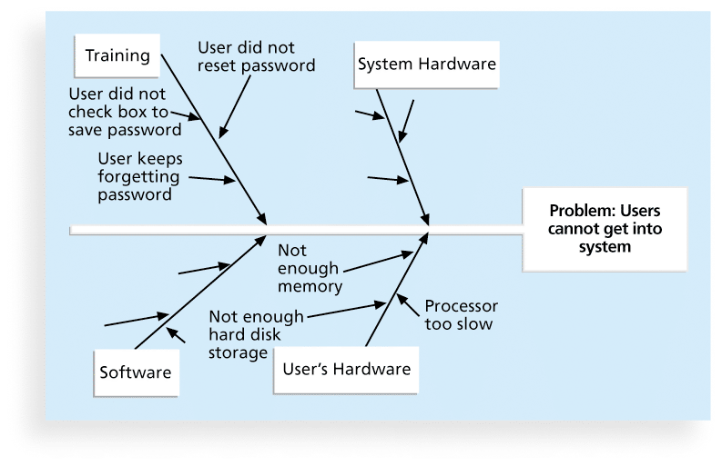
Figure 8-2. Sample Cause-and-Effect Diagram

Slide 23
Scatter diagram
A scatter diagram helps to show if there is a relationship between two variables
The closer data points are to a diagonal line, the more closely the two variables are related

Slide 24
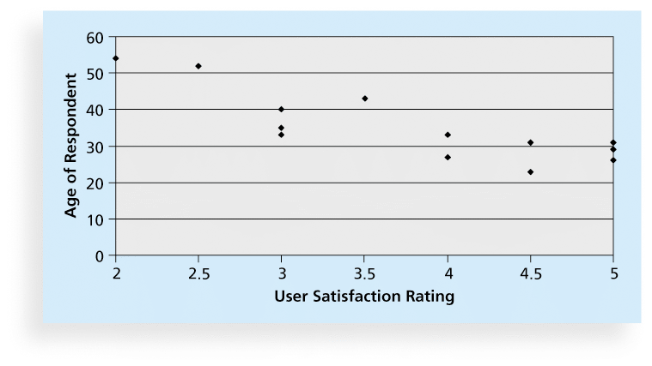
Figure 8-5. Sample Scatter Diagram

Slide 25
Quality Control Charts
A control chart is a graphic display of data that illustrates the results of a process over time
The main use of control charts is to prevent defects, rather than to detect or reject them
Quality control charts allow you to determine whether a process is in control or out of control
When a process is in control, any variations in the results of the process are created by random events; processes that are in control do not need to be adjusted
When a process is out of control, variations in the results of the process are caused by non-random events; you need to identify the causes of those non-random events and adjust the process to correct or eliminate them

Slide 26
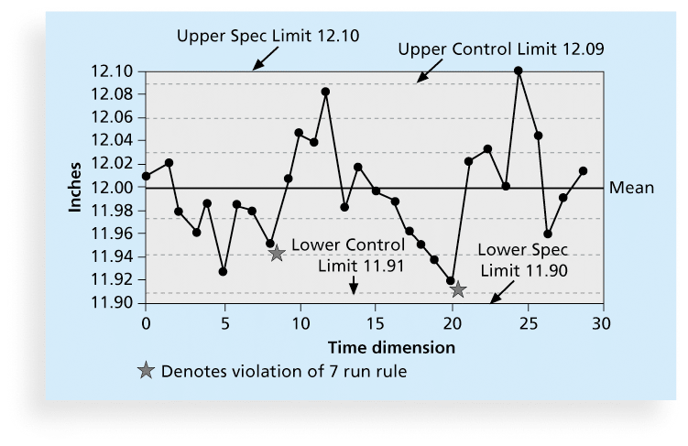
Figure 8-3. Sample Quality Control Chart

Slide 27
Improving Information Technology Project Quality
Several suggestions for improving quality for IT projects include:
Establish leadership that promotes quality
Understand the cost of quality
Focus on organizational influences and workplace factors that affect quality
Follow maturity models

Slide 28
The Cost of Quality
The cost of quality is the cost of conformance plus the cost of nonconformance
Conformance means delivering products that meet requirements and fitness for use
Cost of nonconformance means taking responsibility for failures or not meeting quality expectations
A study reported that software bugs cost the U.S. economy $59.6 billion each year and that one third of the bugs could be eliminated by an improved testing infrastructure

Slide 29
Five Cost Categories Related to Quality
Prevention cost: Cost of planning and executing a project so it is error-free or within an acceptable error range
Appraisal cost: Cost of evaluating processes and their outputs to ensure quality
Internal failure cost: Cost incurred to correct an identified defect before the customer receives the product
External failure cost: Cost that relates to all errors not detected and corrected before delivery to the customer
Measurement and test equipment costs: Capital cost of equipment used to perform prevention and appraisal activities

Slide 30
Chapter Summary
Project quality management ensures that the project will satisfy the needs for which it was undertaken
Main processes include:
Plan quality
Perform quality assurance
Perform quality control

Slide 31
2.3 Điều khiển chất lượng (Perform Quality Control)
Cách vẽ Biểu đồ Pareto
Phân tích biểu đồ: Những cột cao hơn thể hiện lỗi xảy ra nhiều nhất, cần được ưu tiên giải quyết. Những cột này tương ứng với đoạn đường cong có tần suất tích lũy tăng nhanh nhất (hay có độ dốc lớn nhất).
Những cột thấp hơn (thường là đa số) đại diện cho những lỗi ít quan trọng hơn tương ứng với đoạn đường cong có tần suất tích lũy tăng ít hơn (hay có tốc độ nhỏ hơn).

Slide 32
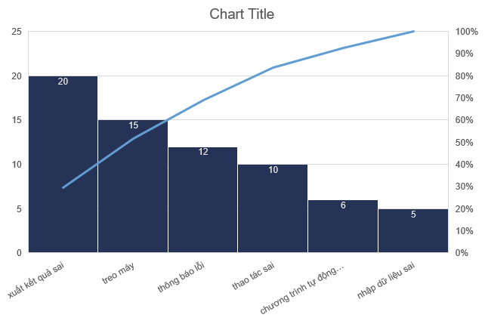
2.3 Điều khiển chất lượng (Perform Quality Control)
Pareto Chart:

